Slide 1
Problem 03 · Intelligent Support Ticket Triage
Problem 05 · Partner Channel Performance Analytics
HPE AI HACKATHON · SINGAPORE
Team SIM (VIP) · Priyashri Narendran, Mothisha Kajendran, Akash Damodaran
Notes:
Introduce the team. Two problems, one idea running through both: use the data to decide where people should spend their attention, and be honest about uncertainty.

Slide 2
Every ticket is routed, or handed to a human
PROBLEM 03 · TICKET TRIAGE
From a ticket's subject, body and product, we predict four things: category, priority (P1–P4), owning team and customer sentiment.
Real priority | Right team | Wrong team | To human
P1 | 0 | 8 | 1.0
P2 | 0 | 2 | 0.5
P3 / P4 | 0 | 1 | 0.3
Then one decision per ticket: route it, or send it to the human triage desk, which can take at most 15% of tickets.
A wrong P1 costs as much as eight P1 hand-offs.
Problem 03 · Ticket Triage · 2
Notes:
The score is a cost, not accuracy. A misrouted urgent ticket is very expensive, so the system has to know when it is unsure and hand off to a human, within the 15% desk capacity.

Slide 3
What 30,000 tickets taught our models
PROBLEM 03 · TICKET TRIAGE
11%
3 teams
35%
1,350
of tickets are P1: the rarest priority, and the costliest to get wrong.
share Firmware tickets, so category alone can't pick the team.
of tickets marked "Critical" by the customer were really P1.
Storage tickets went to Server-HW (local RAID): a team exception.
Task | Macro-F1
Category | 0.865
Priority | 0.759
Team | 0.906
Sentiment | 0.869
Four models, one shared text recipe
1 · Combine product, channel, subject and body into one text.
2 · Read it two ways: word TF-IDF plus 2–5 letter chunks, which survive typos and mixed languages.
3 · Classify: one logistic regression per task; its probabilities drive the hand-off decision.
On 6,000 held-out tickets the models never saw.
Problem 03 · Ticket Triage · 3
Notes:
The data shaped the model: P1 is rare, so classes are balanced; product decides the team in many cases, so product is part of the text; the customer's severity tag is only a weak hint. Macro-F1 treats every class equally, so the model cannot score well by ignoring rare P1 tickets.

Slide 4
Hand off when it's cheaper than guessing
PROBLEM 03 · TICKET TRIAGE
For each ticket we compare the expected cost of routing (chance the team is wrong × penalty) with the fixed hand-off cost, both weighted by the predicted priority.
Routing cost, never abstaining
0.174
Tickets with the biggest saving go to humans, up to 14.5% (cap: 15%)
Tickets under 10 words always go to a human
GreenLake SSO, MFA, API-key and role issues go to Account-Admin, a README rule we confirmed in the data
With our hand-off policy
0.149
About 15% lower, while sending only 14.5% of tickets to the desk.
Problem 03 · Ticket Triage · 4
Notes:
This is the core idea: we do not try to be right as often as possible, we try to make the cheapest mistakes. A wrong P1 costs 8, a hand-off costs 1, so we are most careful exactly where it matters.

Slide 5
How it handles tricky tickets
PROBLEM 03 · TICKET TRIAGE
Ticket (excerpt) | Trap | Our result
"Wow, what an achievement… rebooted itself four times" | Sarcasm | Angry, Server-HW
"URGENT!!! what's the part number for the front bezel?" | Fake urgency | P4, not P1
"teh vlan 20 isnt pasing trafic sinc upgrde" | Typos | Networking, Network-Support
"SSO broken after cert rotation" (GreenLake) | Team exception | Access, Account-Admin
"The aircon in our server room died" | Unknown category | Sent to human
"it broke" · "it's doing it again" | No information | Sent to human
Curveball file: 13 of 15 handled as intended in our own review. The other 2 (a German ticket and an all-caps rant) were safely sent to humans.
Problem 03 · Ticket Triage · 5
Notes:
Walk through two or three rows, then offer to show them live in the app. Be honest about the two the model could not route itself.

Slide 6
Headline numbers mislead
PROBLEM 05 · PARTNER CHANNEL ANALYTICS
$37.8M
−3% to −5%
One order line inflated EMEA's Q1 2026 by 15%. We excluded it from every trend and forecast.
Revenue dips from Q2 to Q3 every year, so a Q3 plan must not copy Q2.
58%
89% vs 98%
of revenue comes from AMS, growing +41% year on year and led by Platinum distributors: growth, but concentrated.
target attainment for Silver vs Business. GreenLake earns the best margin (21.7%) on only 10% of revenue.
Every insight has its own chart in the live dashboard.
Problem 05 · Partner Channel · 6
Notes:
Lead with the outlier: one $37.8M order line, more than 40 times bigger than any other, would make EMEA and GreenLake look like they boomed. Then seasonality, concentration in AMS, and the margin opportunity in GreenLake.

Slide 7

Who will leave the channel in Q3?
PROBLEM 05 · PARTNER CHANNEL ANALYTICS
1 · Time travel
2 · Gap model
3 · Fade boost
No churn labels exist, so we snapshot every past quarter and record who went quiet next.
Gradient boosting learns that rare, irregular buyers who go silent are the ones who leave.
New in 2026: 22 partners shrank 4+ quarters in a row (6 a year ago). We raise their risk.
Ranking leavers (ROC-AUC) | Score
Our health score | 0.870
Days since last order alone | 0.695
Revenue trend alone | 0.451
91 partners flagged (3.5%) | Count
Mixed signals | 33
Gone quiet | 30
Fading | 18
Irregular buyer | 10
Tested on quarters the model never saw (2025 Q4 – 2026 Q1).
Every flag comes with a plain-language reason.
Problem 05 · Partner Channel · 7
Notes:
Example reason: "Revenue fell 5 quarters in a row; -61% vs the same quarter last year; last order 5 days ago" for a Platinum partner. History cannot teach a model a trend that never happened before, so the fade boost is a targeted early warning; it cost only 0.001 AUC on history. Honest limit: most quiet partners come back, so a flag means "call this partner", not "they are gone".

Slide 8
Q3 2026 revenue forecast: $1.135B
PROBLEM 05 · PARTNER CHANNEL ANALYTICS
Region | Q3 2026 | 80% range | vs Q3 2025
APJ | $192M | $182–204M | +8%
EMEA | $227M | $215–241M | +8%
AMS | $715M | $675–758M | +43%
All | $1,135M | $1,071–1,202M | +28%
Average error, 4 past quarters
3.0%
Average of 3 simple methods (seasonal growth, Q2→Q3 ratio, trend + season), corrected for half of their past over-forecast. Q3 is −4.1% vs Q2, in line with −5.2% last year.
All = sum of the three regions. Outlier order excluded.
Problem 05 · Partner Channel · 8
Notes:
Ten quarters is too little for a complex model, so we used three explainable methods and tested each by pretending it was an earlier quarter. The range comes from those real past errors. Risk to call out: AMS is 63% of the forecast; if its growth slows, the total misses.

Slide 9
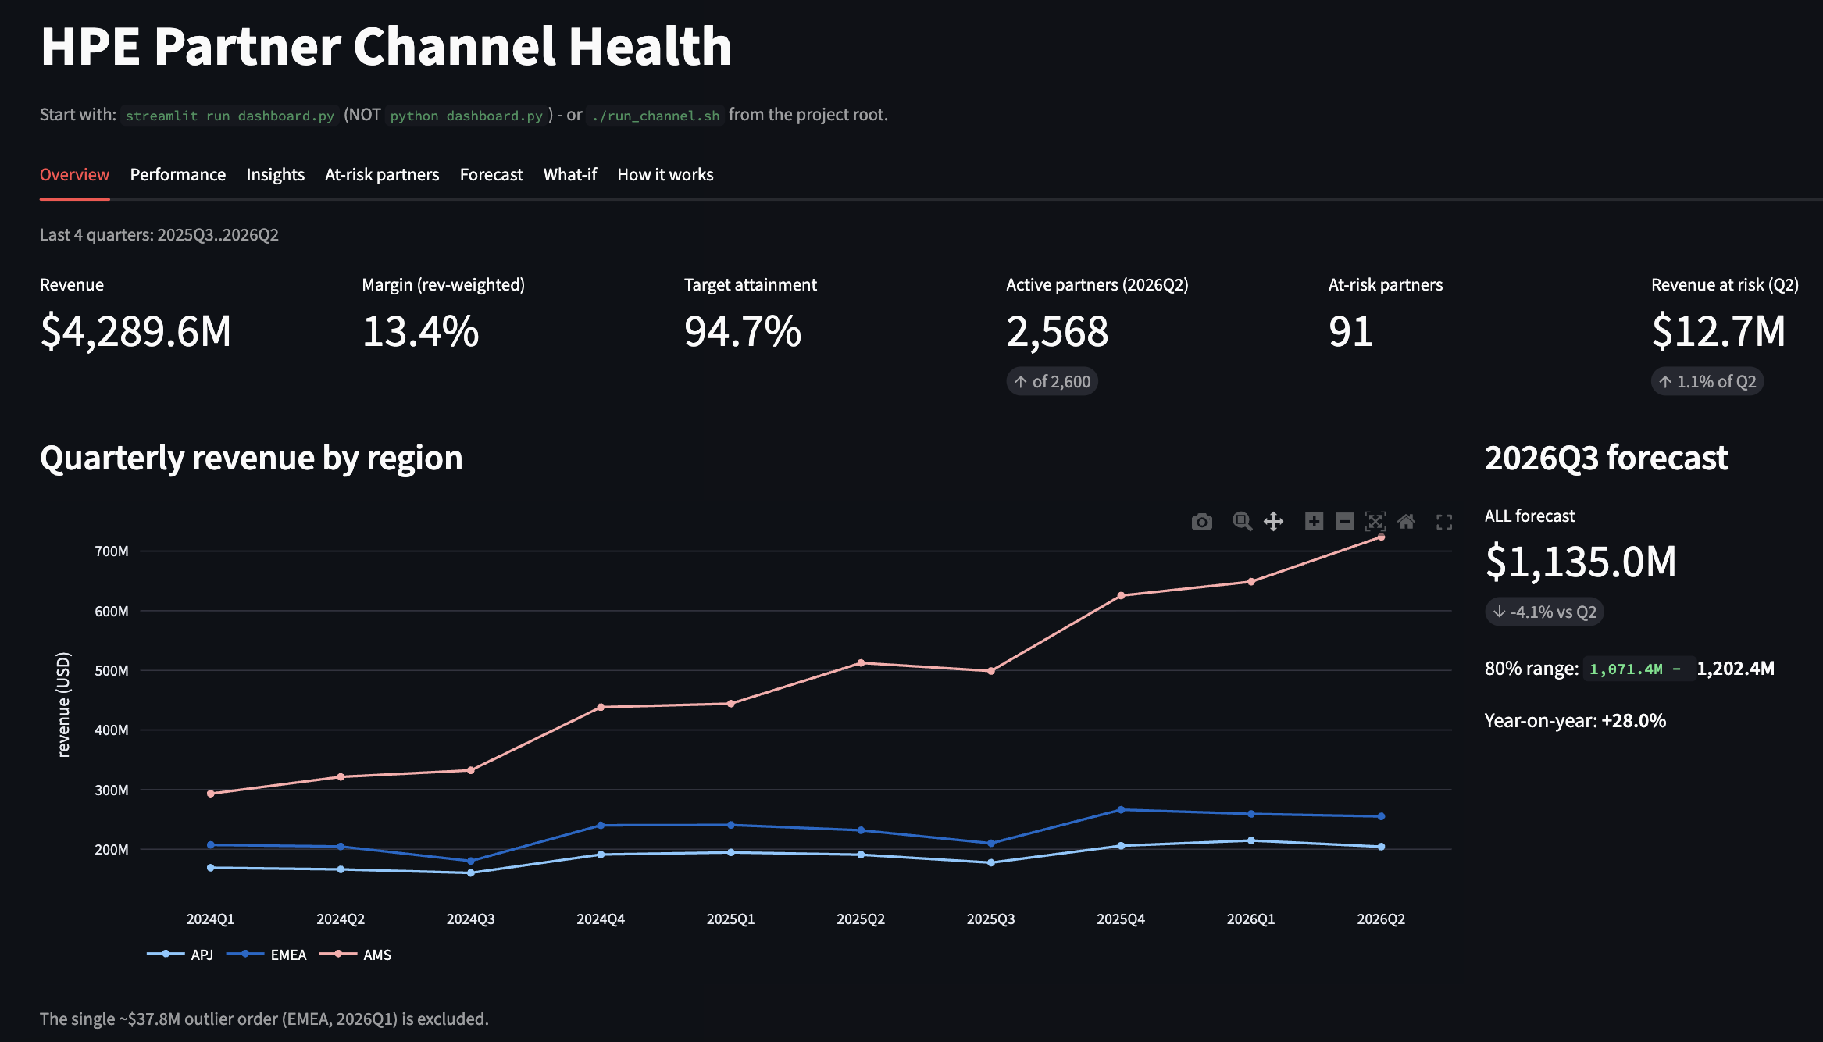
Two working apps the judges can try live
PROBLEM 03 · TRIAGE APP
PROBLEM 05 · CHANNEL DASHBOARD
Streamlit page → FastAPI backend → saved models. Paste a ticket or upload a CSV; see a clear ROUTE or SEND TO HUMAN, an escalation warning, and the words behind the decision.
Streamlit + FastAPI. Overview, performance by region, tier and product, insights, at-risk partners with reasons, the Q3 forecast and a what-if on targets.
Each starts locally with one command documented in our README.
Both problems · 9
Notes:
Switch to the live demo here. Problem 03: paste a normal ticket, then the aircon curveball. Problem 05: Insights tab, then At-risk filtered to Fading, then Forecast.

Slide 10
Business impact, honest limits, what's next
 | Ticket triage | Partner channel
Impact | Routing cost about 15% lower; urgent tickets reach the right team or a human. | 91 partners to call before Q3, each with a reason; a realistic Q3 plan with a range.
Limits | Priority is the weakest task (F1 0.759); German and Malay tickets are handed off. | Most quiet partners come back; AMS drives 63% of the forecast.
Next | Add business-impact signals; compare an LLM zero-shot via the gateway. | Track the flagged partners' Q3 outcome; LLM narratives grounded in our numbers.
Thank you. Questions?
Both problems · 10
Notes:
Close on the shared idea: spend human attention where the data says it matters, and say plainly where the models are unsure.

